Slide 1

Bob Young Nursery
Wide Variety of First Class Field Grown Material

Slide 2
Bob Young’s – Vendor Terms
Top Quality B&B material
Minimum Order: $2,500
  Prefers filling his own truck – uses Rameriz for shipping
Will ship in fall
  Has a do not ship in fall list
Must ship by May 1st
Order Deadline for first round of allocations: 9.15.25
Confirms mid-October
Strip tags only
No cherry-picked orders
  Cannot order just dogwoods and redbuds

Slide 3

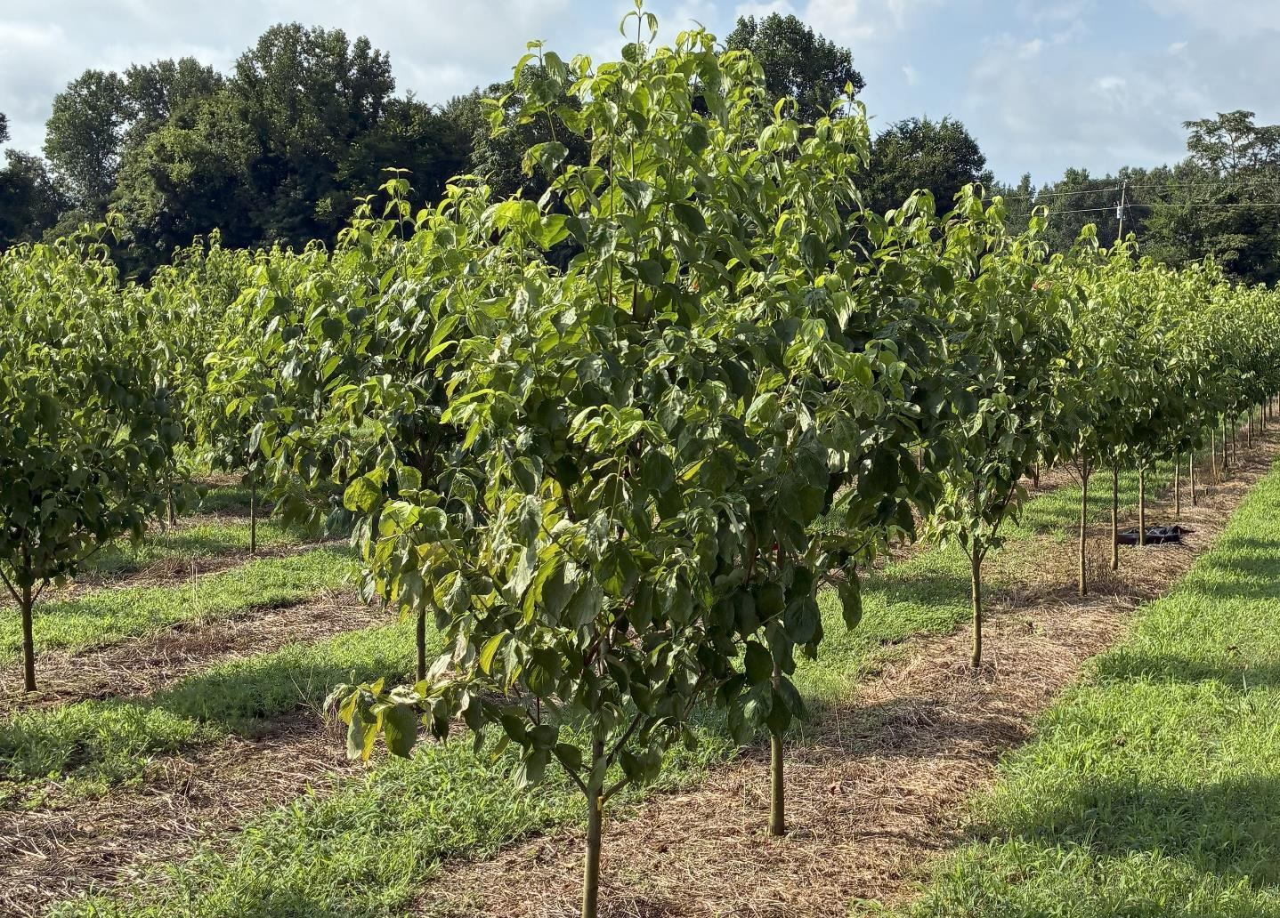

Dogwoods and Redbuds are coming back!
Recent tours have reported that the crop appears to be back to Bob Young’s traditional quality.
Numbers on Florida varieties (pictured) best in the past 5 seasons.

Slide 4
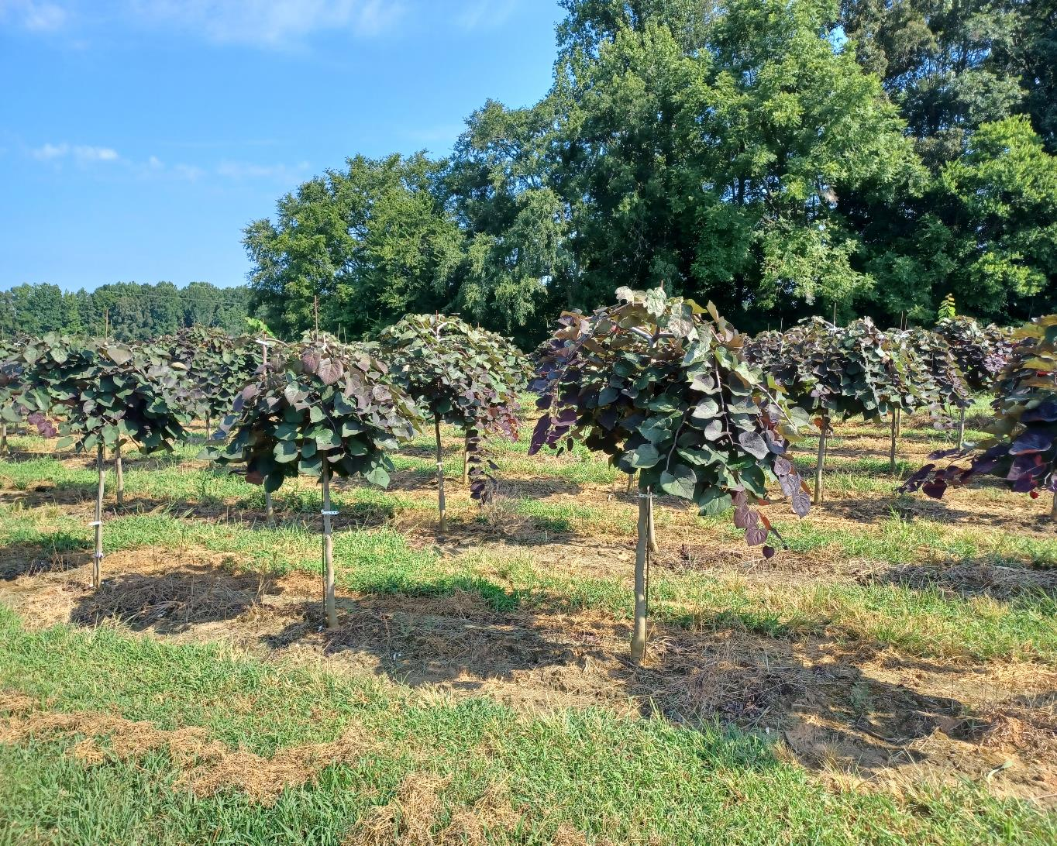
Redbuds up to 2” this season
Varieties will include:
Forest Pansy, Flame Thrower, Golden Falls, Pink Heartbreaker, straight species and others.
(pictured Ruby Falls)

Slide 5
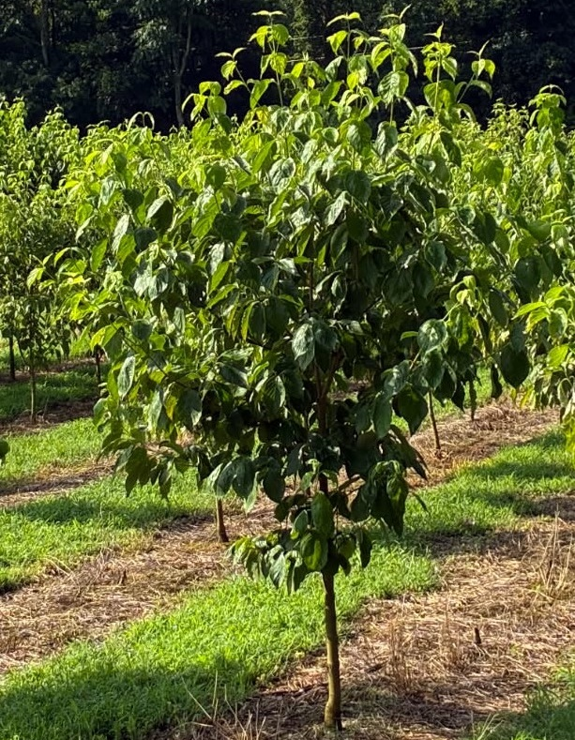
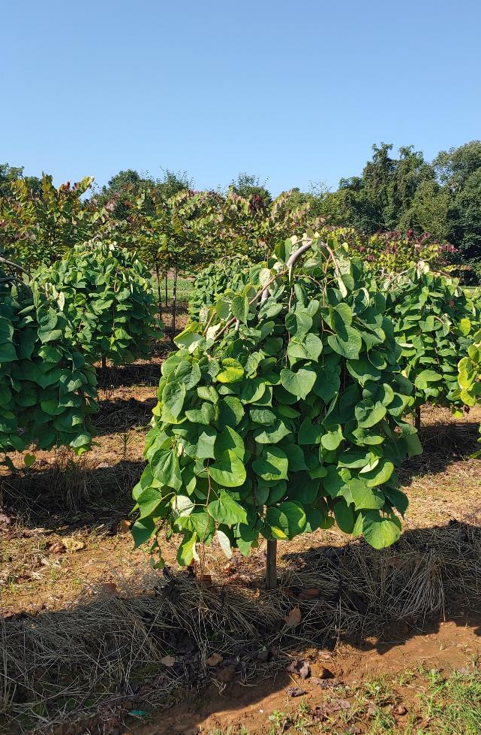

Cornus florida ‘Appalachia Snow’
1.5” - $114
1.75” - $137
2” - 156
Cercis ‘Golden Falls’ (right)
1.5” - $130
1.75” - $153
2” - $172
Volume discounts available

Slide 6
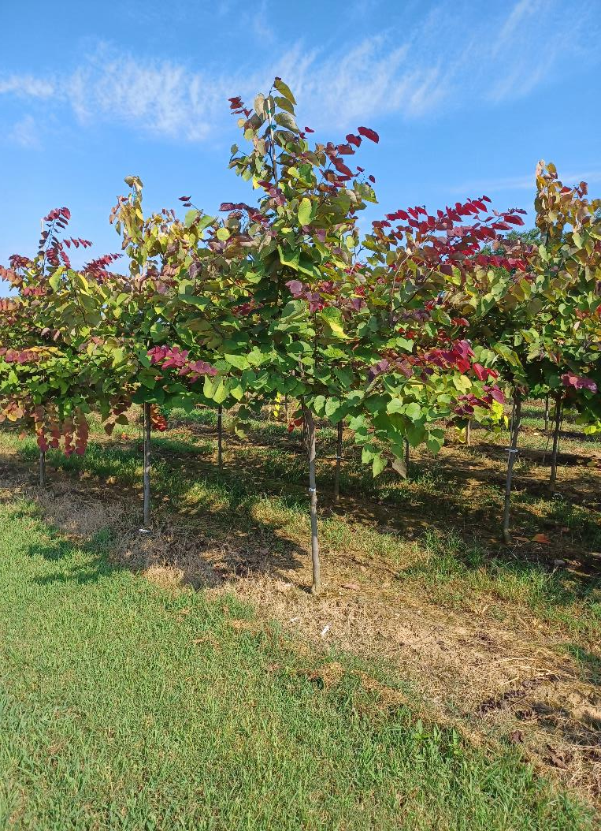
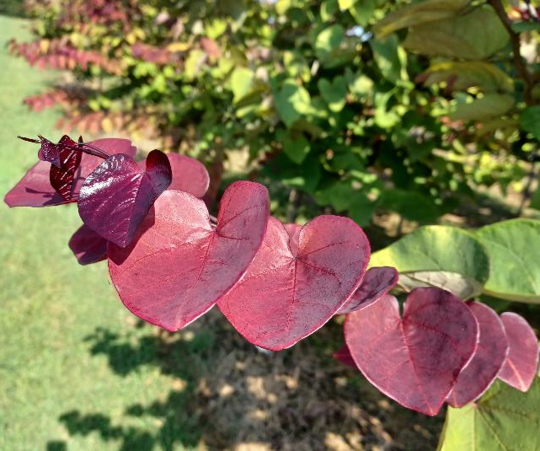
Cercis c. ‘Flame Thrower’
1.25” - $109
1.5” - $130
1.75” – $153
Volume discounts available

Slide 7
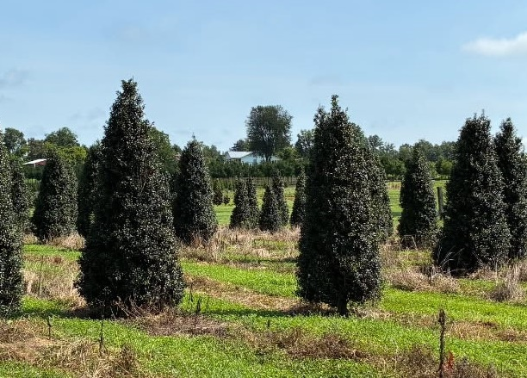

Dragon Lady Holly (pix)
7’ - $181
8’ - $212
9’ - $234
10’ - $260
Other Hollies available include:
Greenleaf Opaca – 6’, 7’ & 8’
Satyr Hill – 6’ & 7’
Nellie Stevens – 5’, 6’ & 7’
Foster Holly – 5’, 6’ & 7’
Volume discounts available

Slide 8
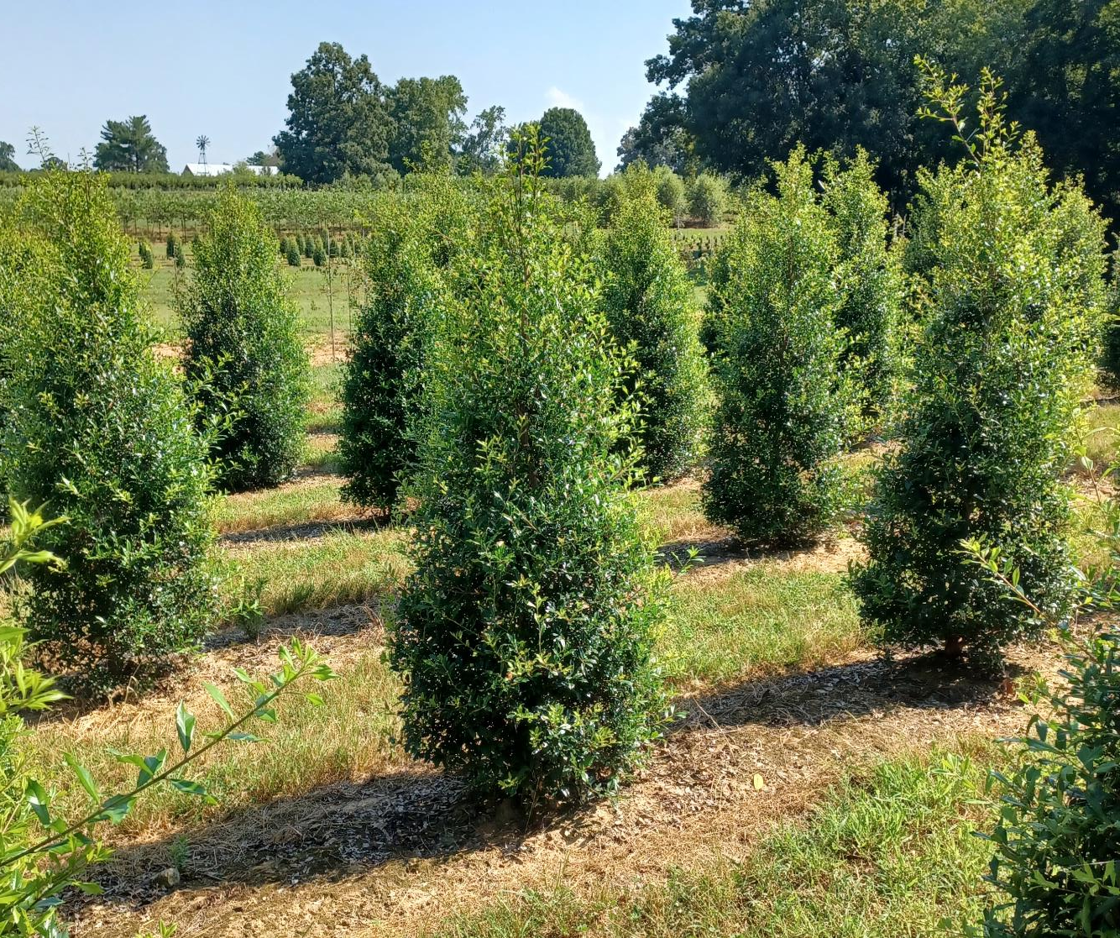
Fosteri Holly (pix)
5’ - $120
6’ - $135
7’ - $166
Volume discounts available

Slide 9
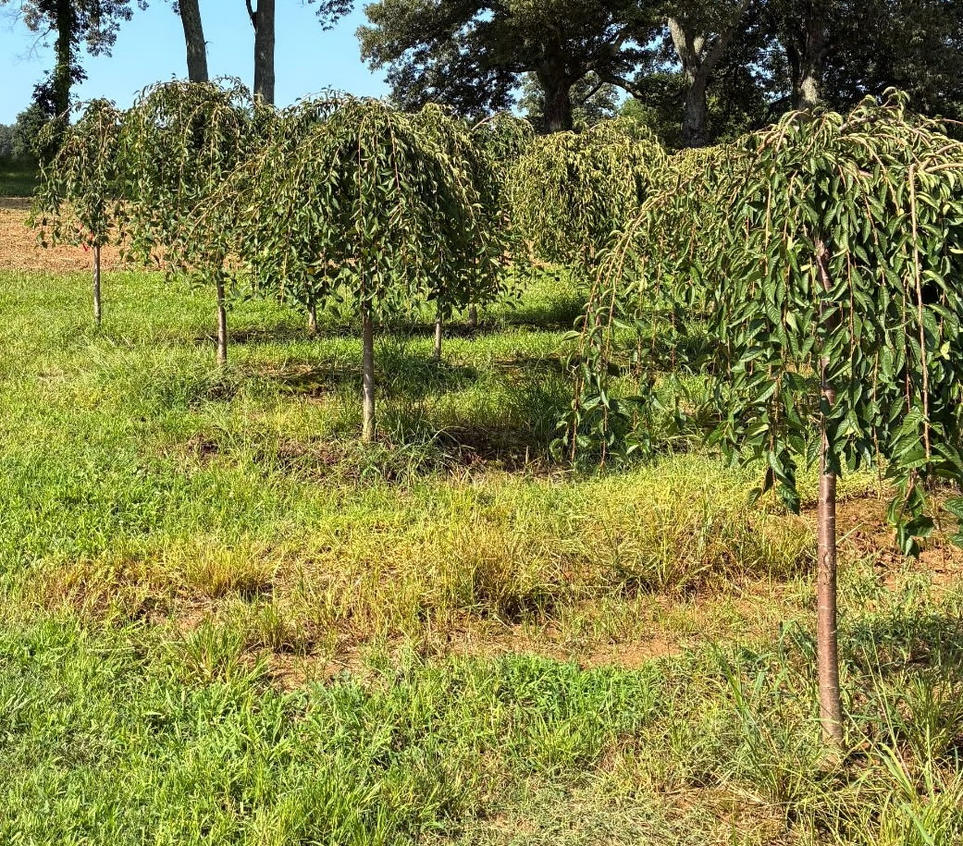
Prunus sub. ‘Pendula’-(pictured) – .
1.75” – $151
2” - $164
2.5” - $187
Other Cherries include: Snow Fountain, Kwanzan, Autumnalis, Okame & Yoshino

Slide 10
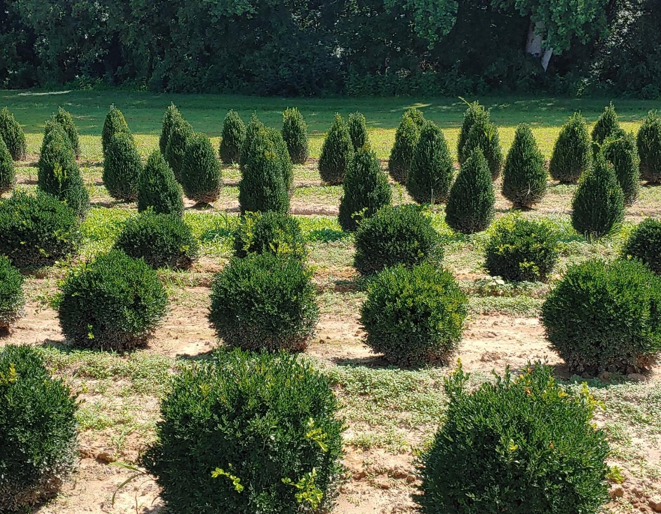

Buxus ‘Green Velvet’
18” - $60
24” – $69
30” - $77
Buxus ‘Green Mountain’ (right) – 24”- $62
30” - $69
36” - $77
42” - $88
Volume discounts available

Slide 11
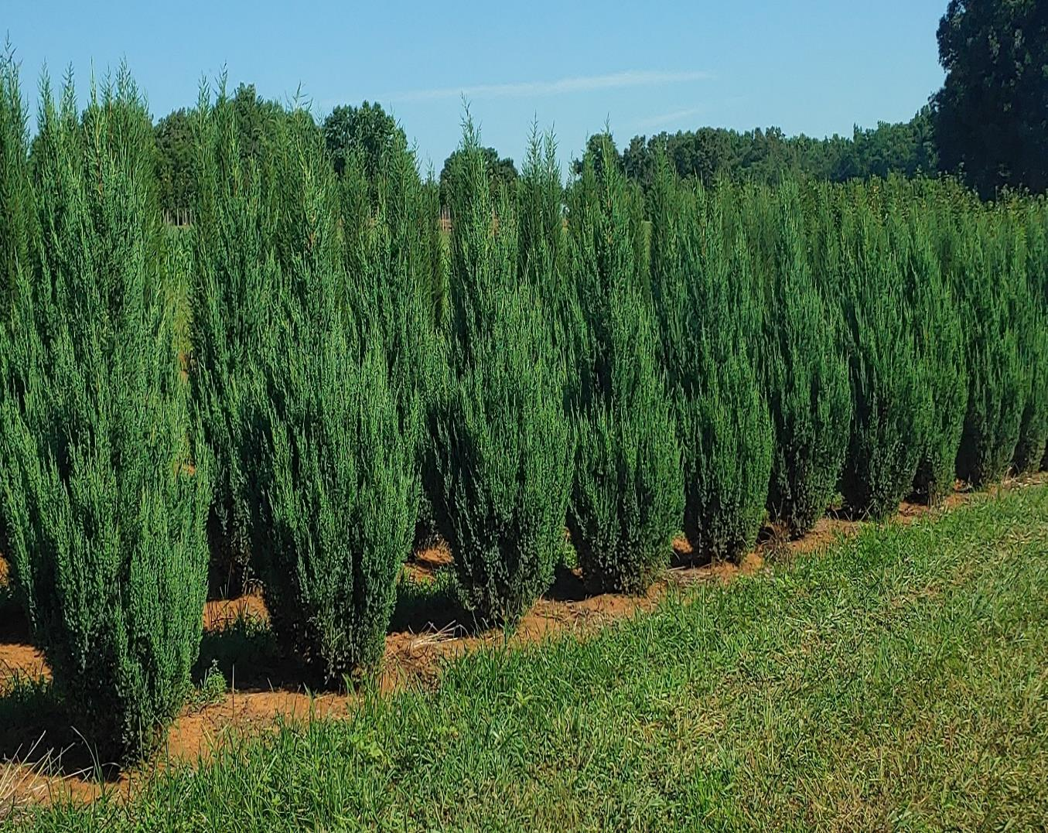

Juniperus Blue Point –
6’ - $120
7’ - $135
Also growing Burkii and close to having Taylor’s available

Slide 12
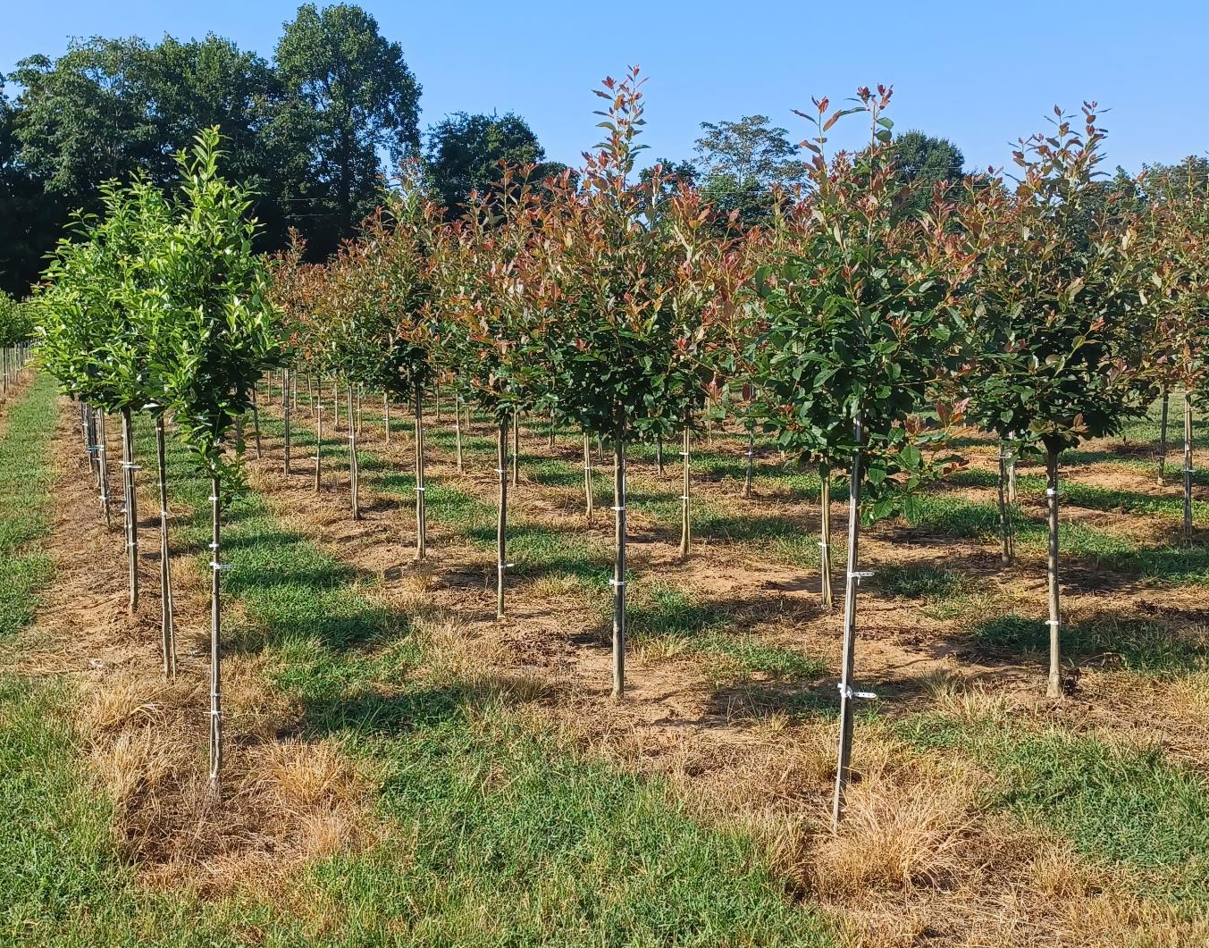
Nyssa syl. ‘Green Gable’
Nyssa syl. ‘Wildfire’ (rt)
1.5” - $118
1.75” - $142
2” - $161
Volume discounts available

Slide 13
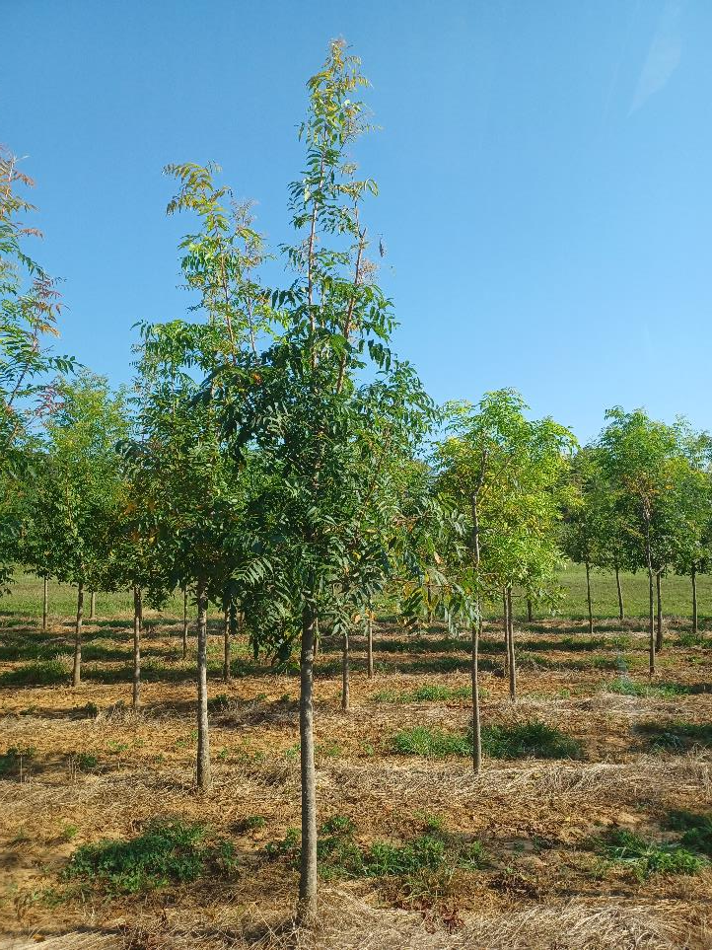
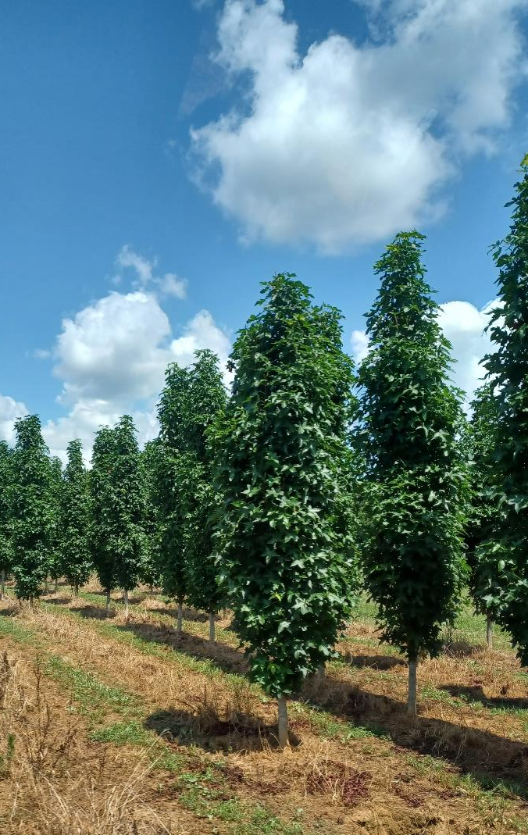
Pistache Chinesis
2” - $140
2.5” - $156
Liriodendron tulipfera ‘Arnold’
2” - $130
2.5” - $151
3” - $172
Volume discounts available

Slide 14
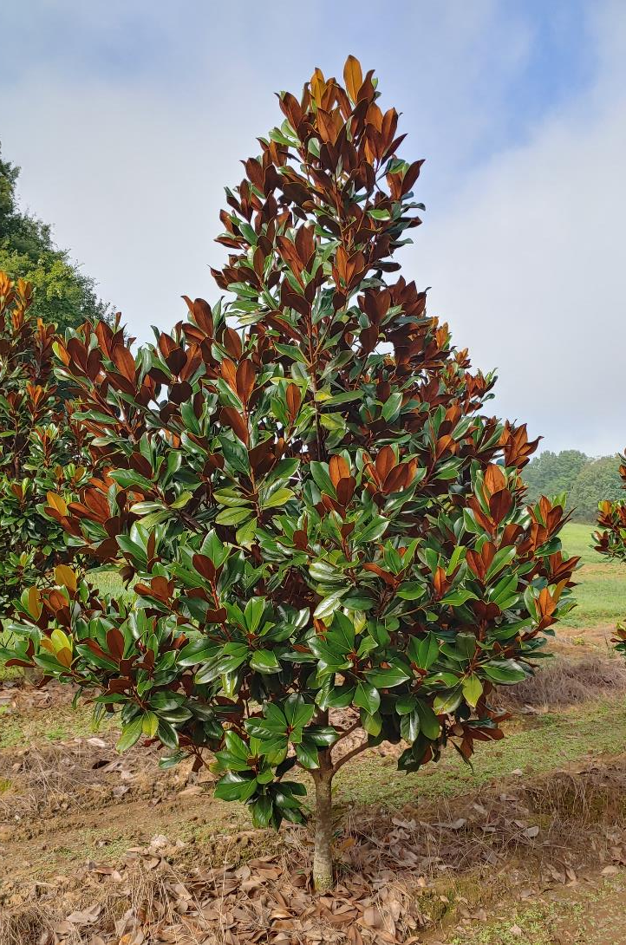
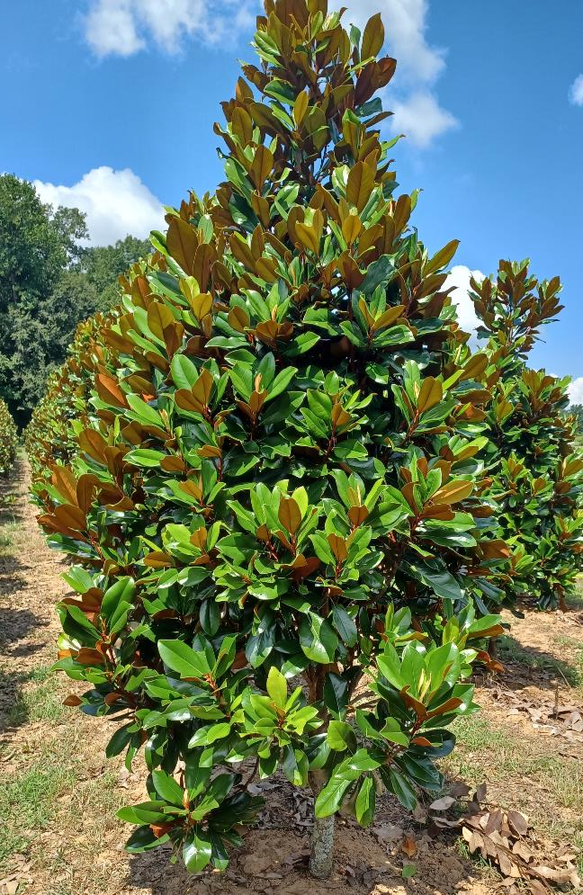
Magnolia grand. ‘D.D. Blanchard’
Magnolia grand ‘Teddy Bear’ (rt)
8’ - $177
9’ - $198
10’ - $229
12’ - $260
Volume discounts available

Slide 15
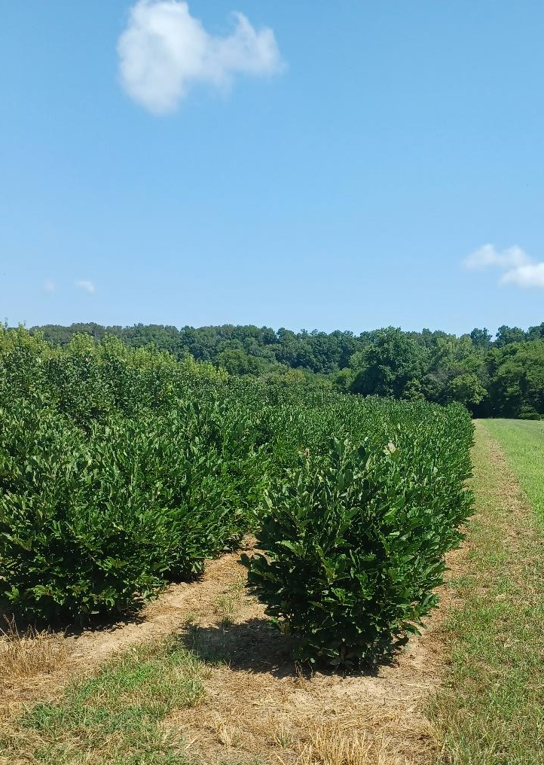
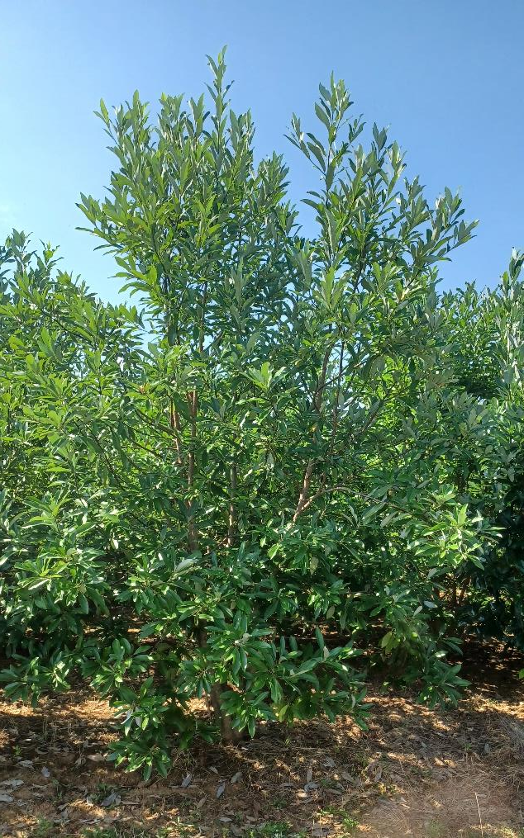
Magnolia virginiana (Sweet Bay) – 9’ pict.
7’ - $136
8’ - $156
9’ - $177
Magnolia stellata ‘Royal Star’ (rt)
4’ - $88
5’ - $109
Volume discounts available

Slide 16
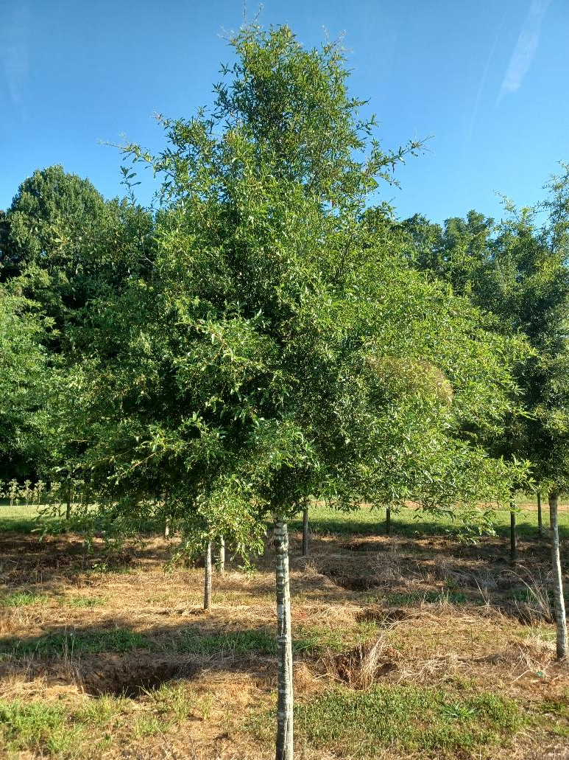
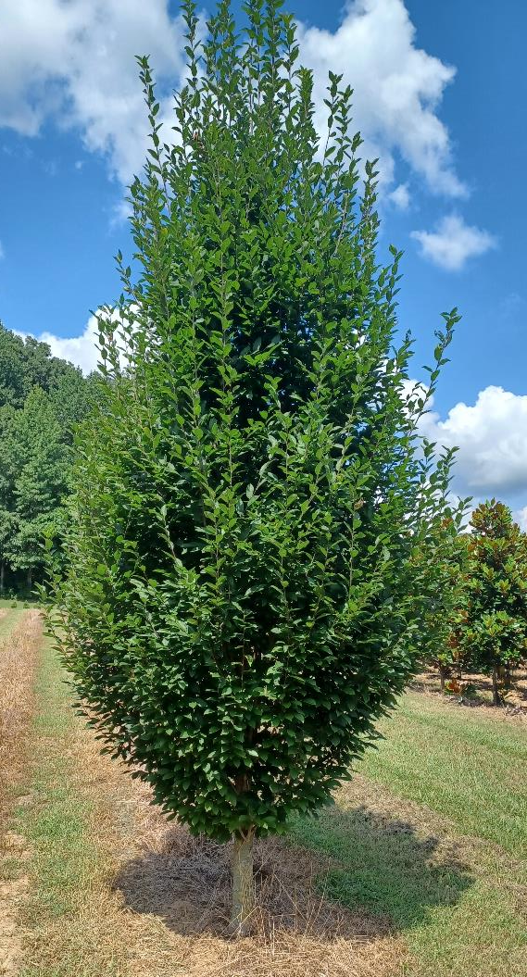
Quercus paultris 2.5”
(up to 4” available)
Carpinus bet. ‘Fastigiata’
1.75” - $133
2” - $154
2.5” - $177
Volume discounts available

Slide 17
